Slide 1
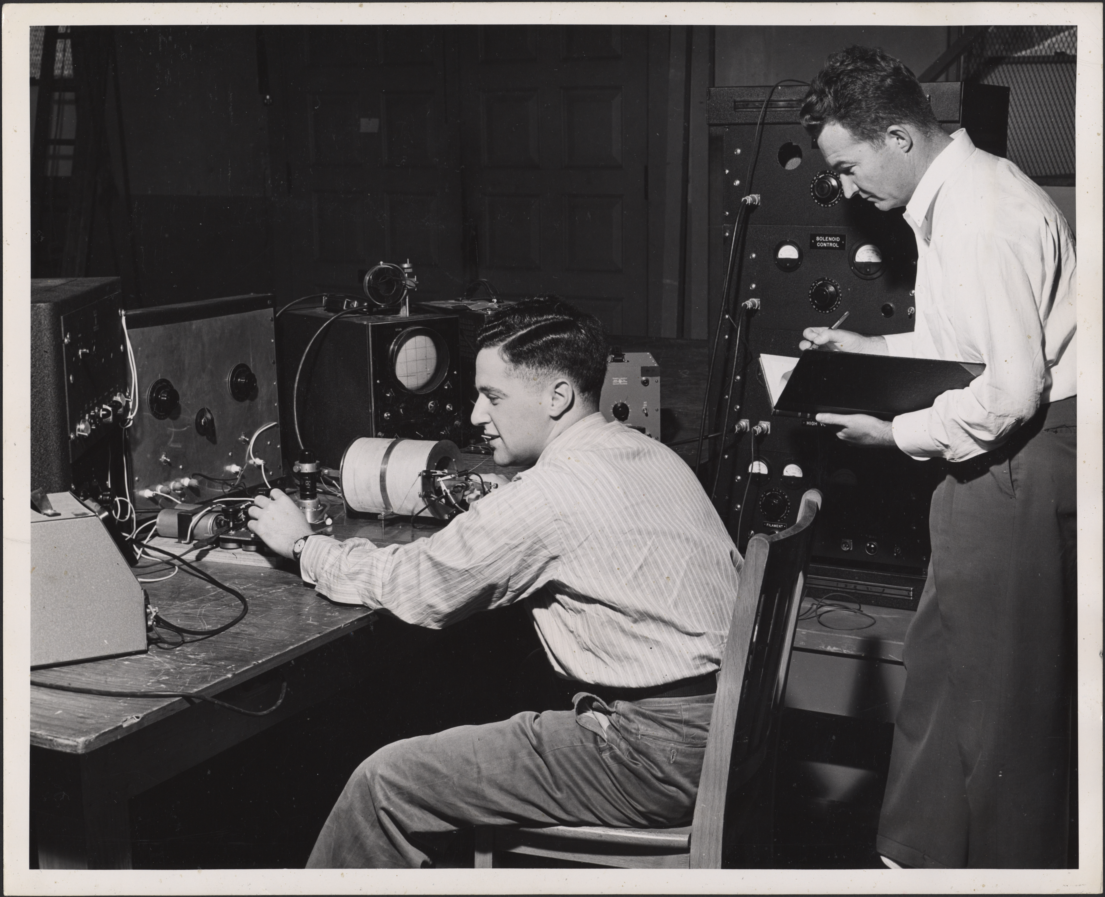
Research Data & the Stanford Digital Repository
Amy Hodge
PhD, Yale, Molecular Biophysics & Biochemistry
Science Data Librarian
amyhodge@stanford.edu
Image courtesy of Stanford University Archives
Notes:
Hi. My name is Amy Hodge, and I’m the science data librarian for Stanford Libraries. I’m going to talk to you today about our data management services and in particular about the Stanford Digital Repository.

Slide 2

Notes:
Back in February, the President’s Office of Science and Technology Policy issued a memo. Some of you may have heard about this memo. It directs federal funding agencies to develop plans to support increased public access to the scientific publications and digital scientific data that are products of that funded research. These plans were due to the OSTP on August 22, but nothing has been publicly announced about those plans just yet. I’m going to talk with you today about how our services can help you in a variety of ways, including meeting these new requirements. I’m going to begin by telling you three quick stories -- true stories -- about some Stanford scientists and their data.
Data are defined as the digital recorded factual material commonly accepted in the scientific community as necessary to validate research findings including data sets used to support scholarly publications. Those
The Office of Science and Technology Policy (OSTP) hereby directs each Federal agency with over $100 million in annual conduct of research and development expenditures to develop a plan to support increased public access to the results of research funded by the Federal Government.
Further, each agency plan for both scientific publications and digital scientific data must contain the following elements: a strategy for improving the public’s ability to locate and access digital data resulting from federally funded scientific research...
...digitally formatted scientific data resulting from unclassified research supported wholly or in part by Federal funding should be stored and publicly accessible to search, retrieve, and analyze. For purposes of this memorandum, data is defined, consistent with OMB circular A-110, as the digital recorded factual material commonly accepted in the scientific community as necessary to validate research findings including data sets used to support scholarly publications,
Each agency’s public access plan shall [among other things]:
1. Ensure that all extramural researchers receiving Federal grants and contracts for scientific research and intramural researchers develop data management plans, as appropriate, describing how they will provide for long-term preservation of, and access to, scientific data in digital formats resulting from federally funded research, or explaining why long-term preservation and access cannot be justified;
2. Promote the deposit of data in publicly accessible databases, where appropriate and available;

Slide 3
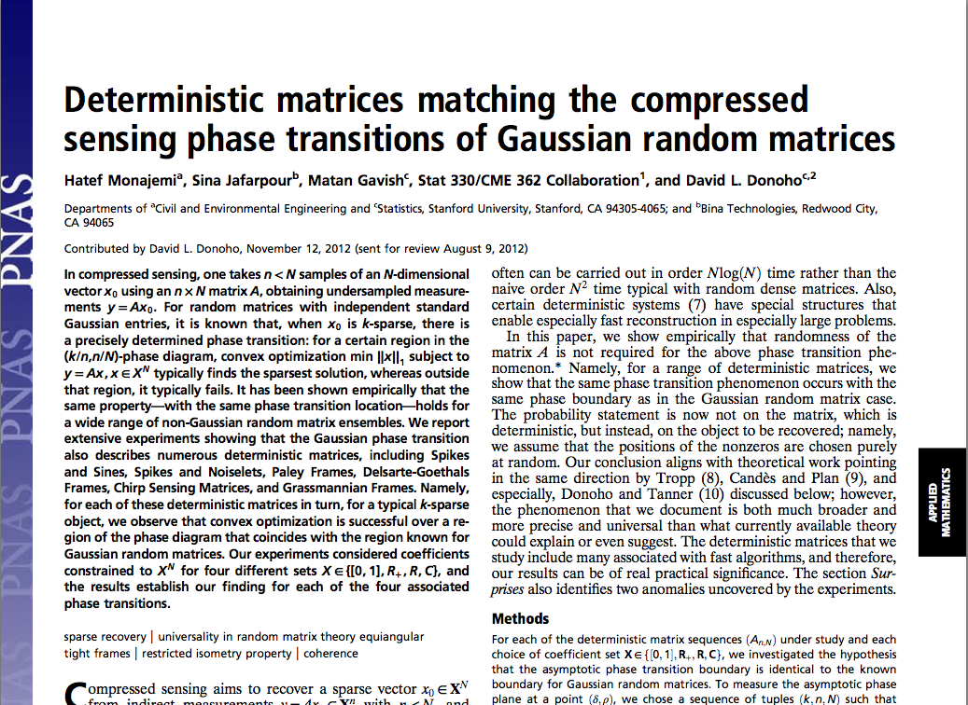
Notes:
The first story is about David Donoho, a professor of Statistics, and his graduate students Hatef and Matan. They were publishing a paper in PNAS, and the journal was requiring that they also make available online supplementary data that supported the results in the paper. David and Hatef and Matan were happy to provide these data files and even the code that had been written for this project, however, the journal did not provide any way to do this. And so Hatef went looking for a solution for how to publish their supplementary data and discovered that....the SDR can do that.

Slide 4
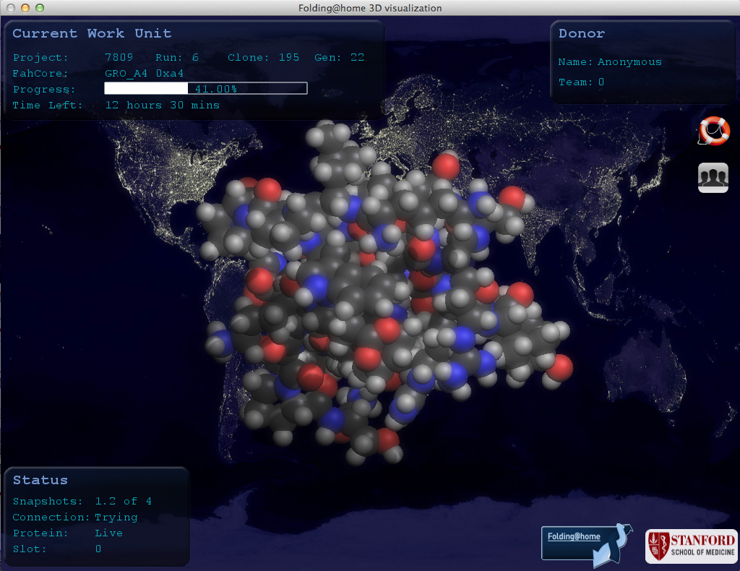
Notes:
My second story is about Vijay Pande, a chemistry professor in BioX and his project Folding@home, which is a long-running project, well-known at Stanford and beyond. They have built software that allows anyone, anywhere in the world, to do protein folding calculations on the spare cycles on their computers. All that data is then compiled and analyzed here at Stanford. Over the years that this project has been running, you can imagine, they have compiled a huge amount of data that they are interested in making easily discoverable by researchers anywhere. The SDR can do that.

Slide 5
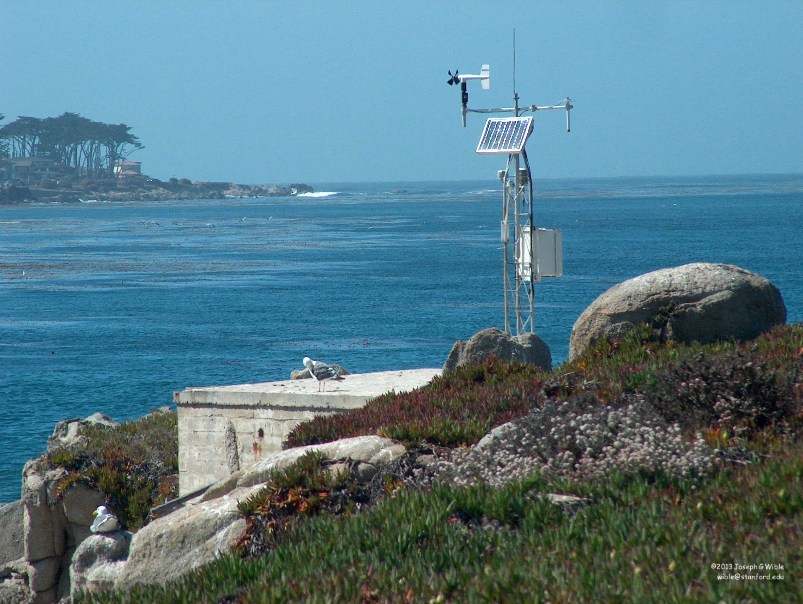
Notes:
My last story is about researchers at Hopkins Marine Station, who are involved in a number of long-term monitoring projects, some of which have been going on for nearly 100 years. This is a weather station where they measure things like wind, precipitation, and temperature every 10 minutes, every day of the year.

Slide 6
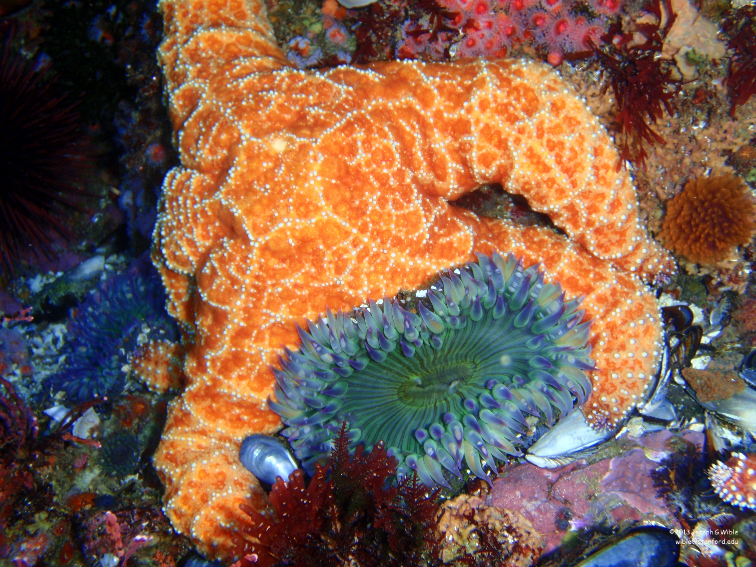
Notes:
They also monitor a variety of marine populations, like kelp and barnacles, as well as the sea stars and sea anemones shown here...

Slide 7
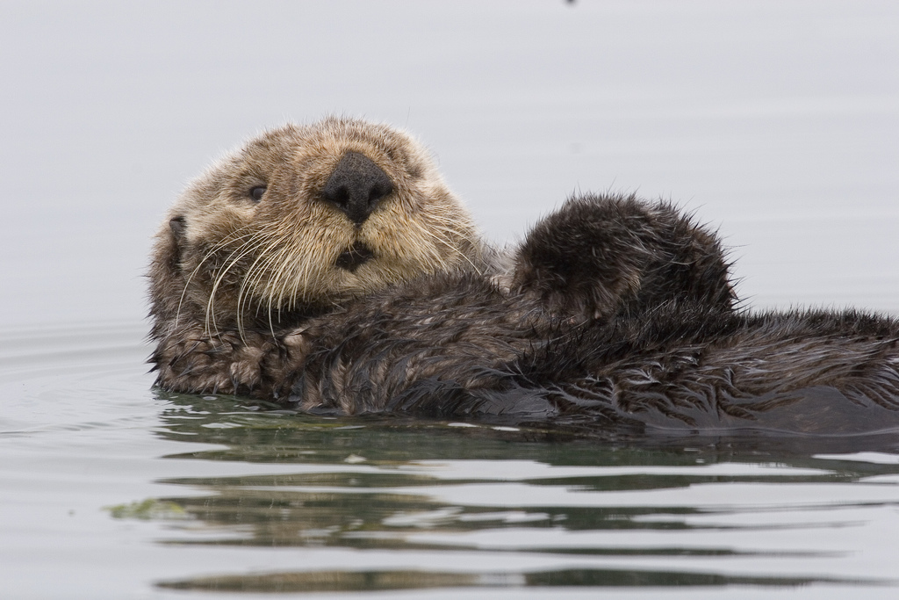
Image by Mike Baird
Notes:
... as well as some of our favorite marine mammal populations like harbor seals, sea otters, and sea lions. Because these data provide insight into broad topics like climate change, and - because of their historical nature - they can't be replicated, it's important that they be preserved for use by other researchers in the future. And you probably know by now that....the SDR can do this too.

Slide 8
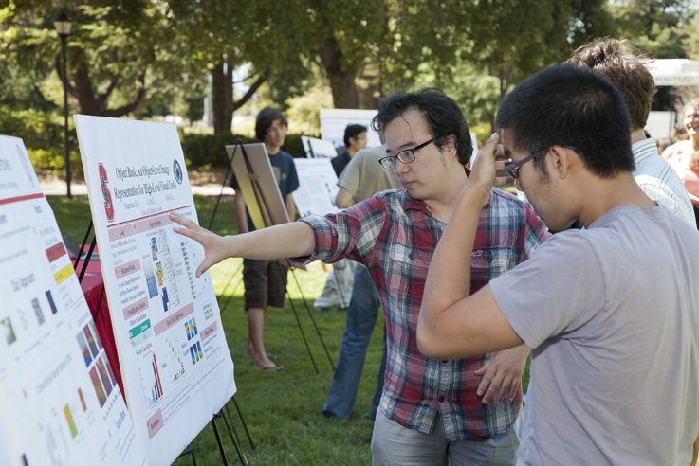
Image by Stanford Engineering, 2011
Notes:
The SDR can also be used to preserve and share things like your department’s undergraduate honors theses...

Slide 9
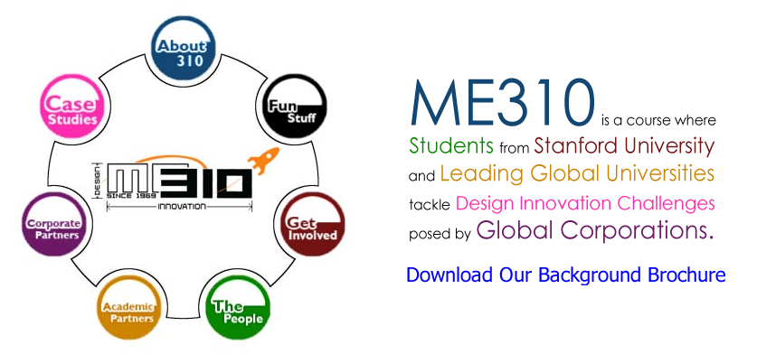
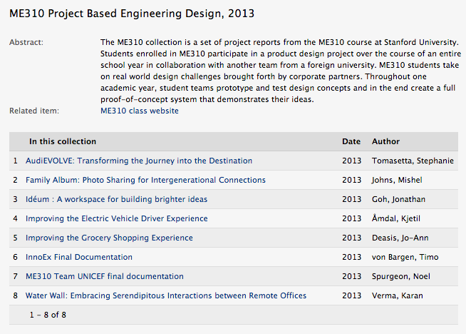
Notes:
... student projects from important courses...

Slide 10
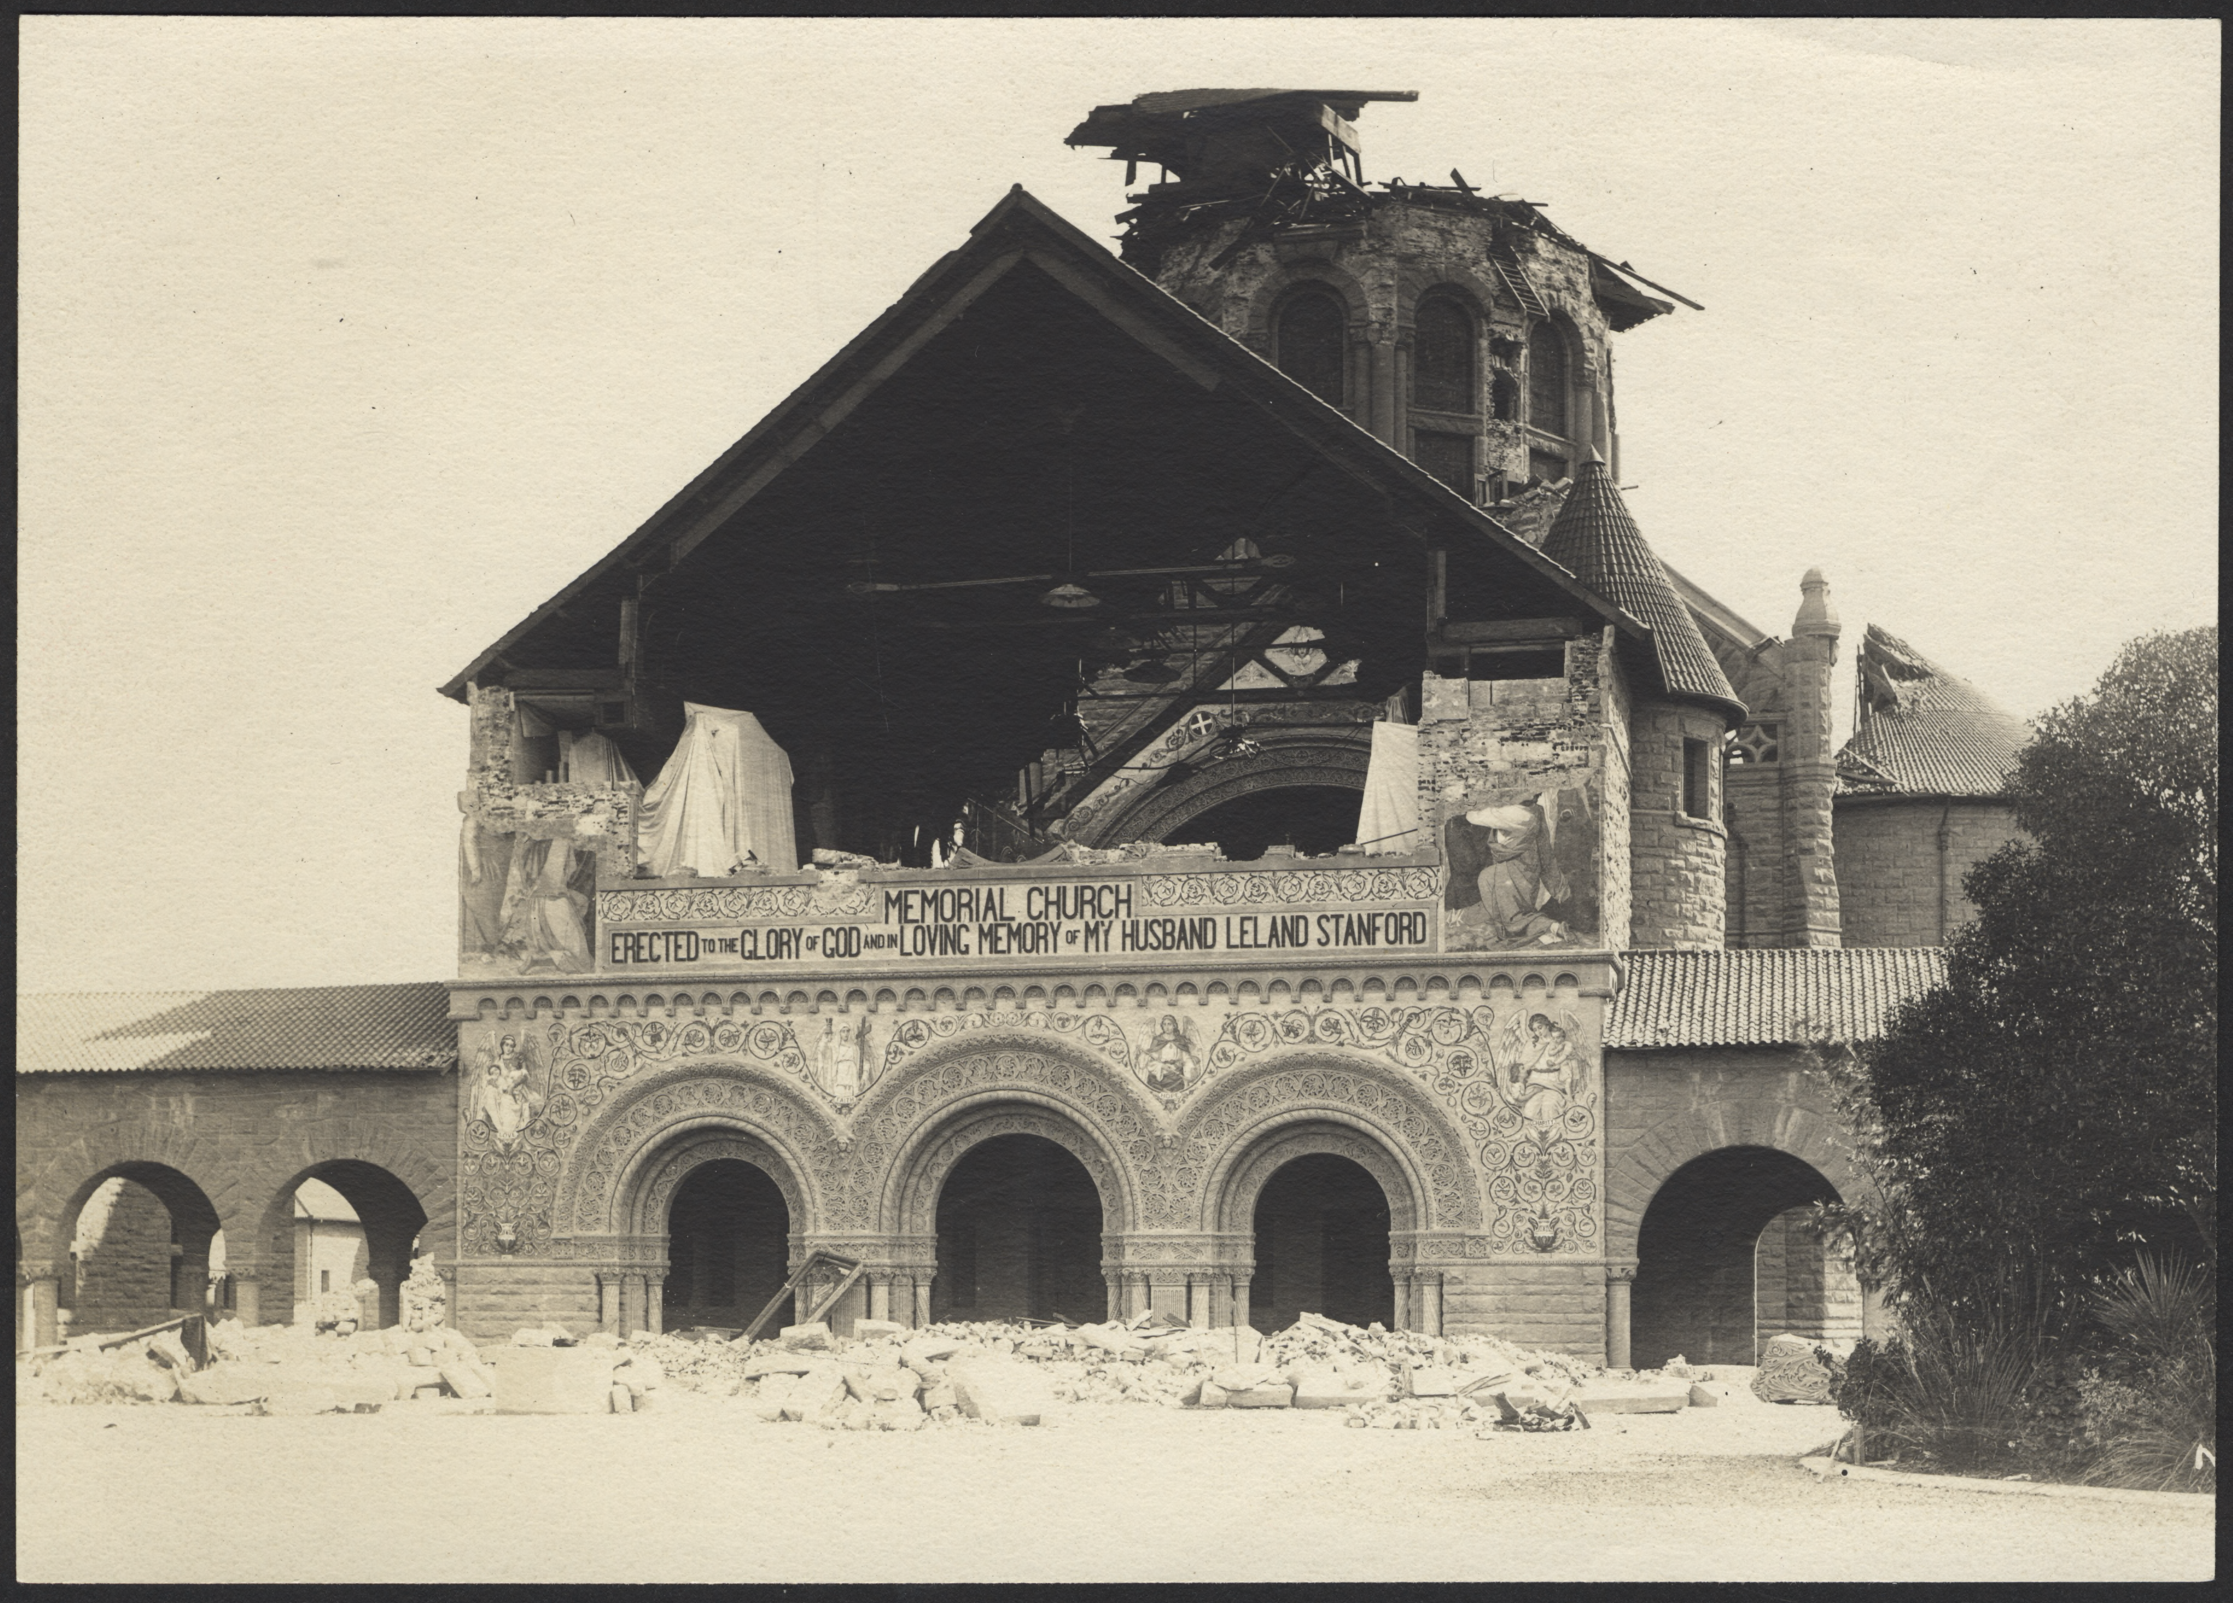
Image by Berton Crandall, 1906, courtesy of Stanford University Archives
Notes:
and technical reports. Deposit is currently in progress for 170 or so technical reports from the John A. Blume Center for Earthquake Engineering.
The question then is, how does the SDR do all of these things?

Slide 11
http://purl.stanford.edu/wp335yr5649
Notes:
The answer is this. The persistent URL, or PURL. When you deposit data into the SDR you get a persistent URL at which that data can always be accessed. Always.

Slide 12
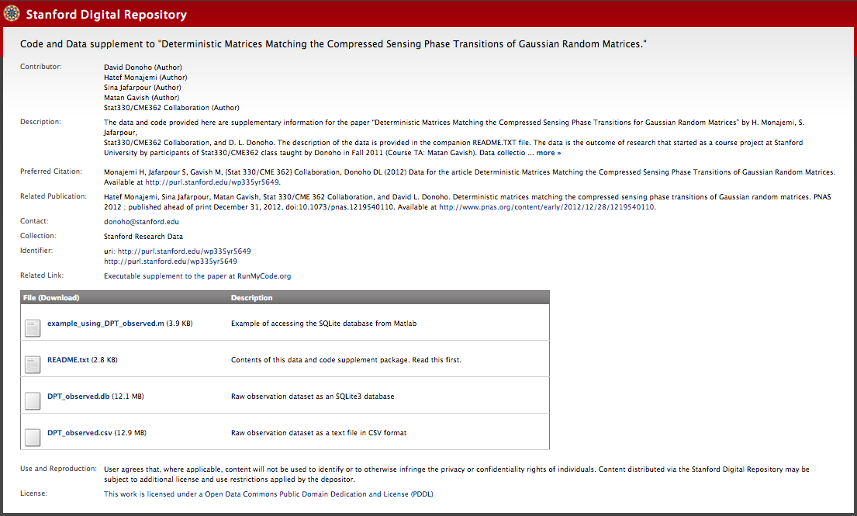
Notes:
Here's what a PURL page for a data deposit looks like. What you see here basically reflects the information that you are required to provide when you deposit data via our self-deposit web interface: authors, a description, how you would like these data to be cited, any associated publications, who to contact about the data, and any other related links. Then there is a list files that can be downloaded with descriptions. You also have options to choose an embargo period, assign a license, and decide whether you want the PURL page to be visible to anyone in the world or just Stanford.
We consider this a lightweight approach to meeting NSF requirements for data sharing and preservation.
And I'm hoping your next question is, How do I get a PURL for my data? It's very easy to do, takes just a few minutes, and three simple steps.

Slide 13
amyhodge@stanford.edu
Notes:
Step one. Email me. Access to the web-based self-deposit interface is via your SUNet ID – and to anyone with a SUNet ID (faculty, research staff, post-docs, students), however, it is currently gated, so I need to specifically give access to whomever is making or reviewing deposits. I’m also available to provide whatever kind of support you might need when you’re depositing data.

Slide 14
sdr.stanford.edu
Notes:
Step two. Go to sdr.stanford.edu. Here you can create a new item, get your persistent URL, upload your files, and describe your data. You will also need to agree to the terms of deposit. The SDR is content agnostic – you can deposit files in any format.

Slide 15

Notes:
Step three. Publish. Easy as that.

Slide 16
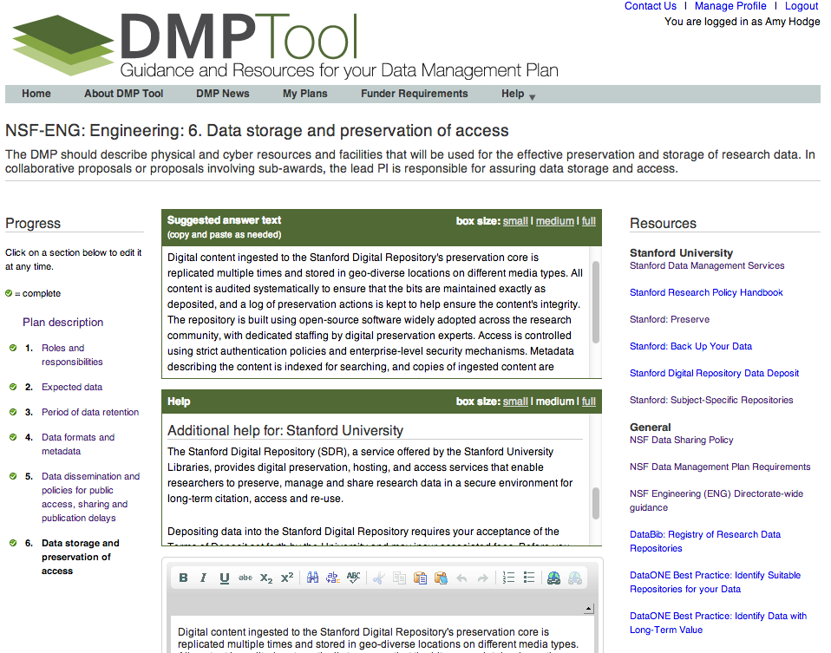
Notes:
Data Management Services also provides other tools and services, including access to the DMPTool, which provides assistance with writing data management plans for research grant proposals. When you log into this tool with your SUNet ID – which you can do right now – you will see resource links, help text, and suggested answer text that is specific to the Stanford community.

Slide 17
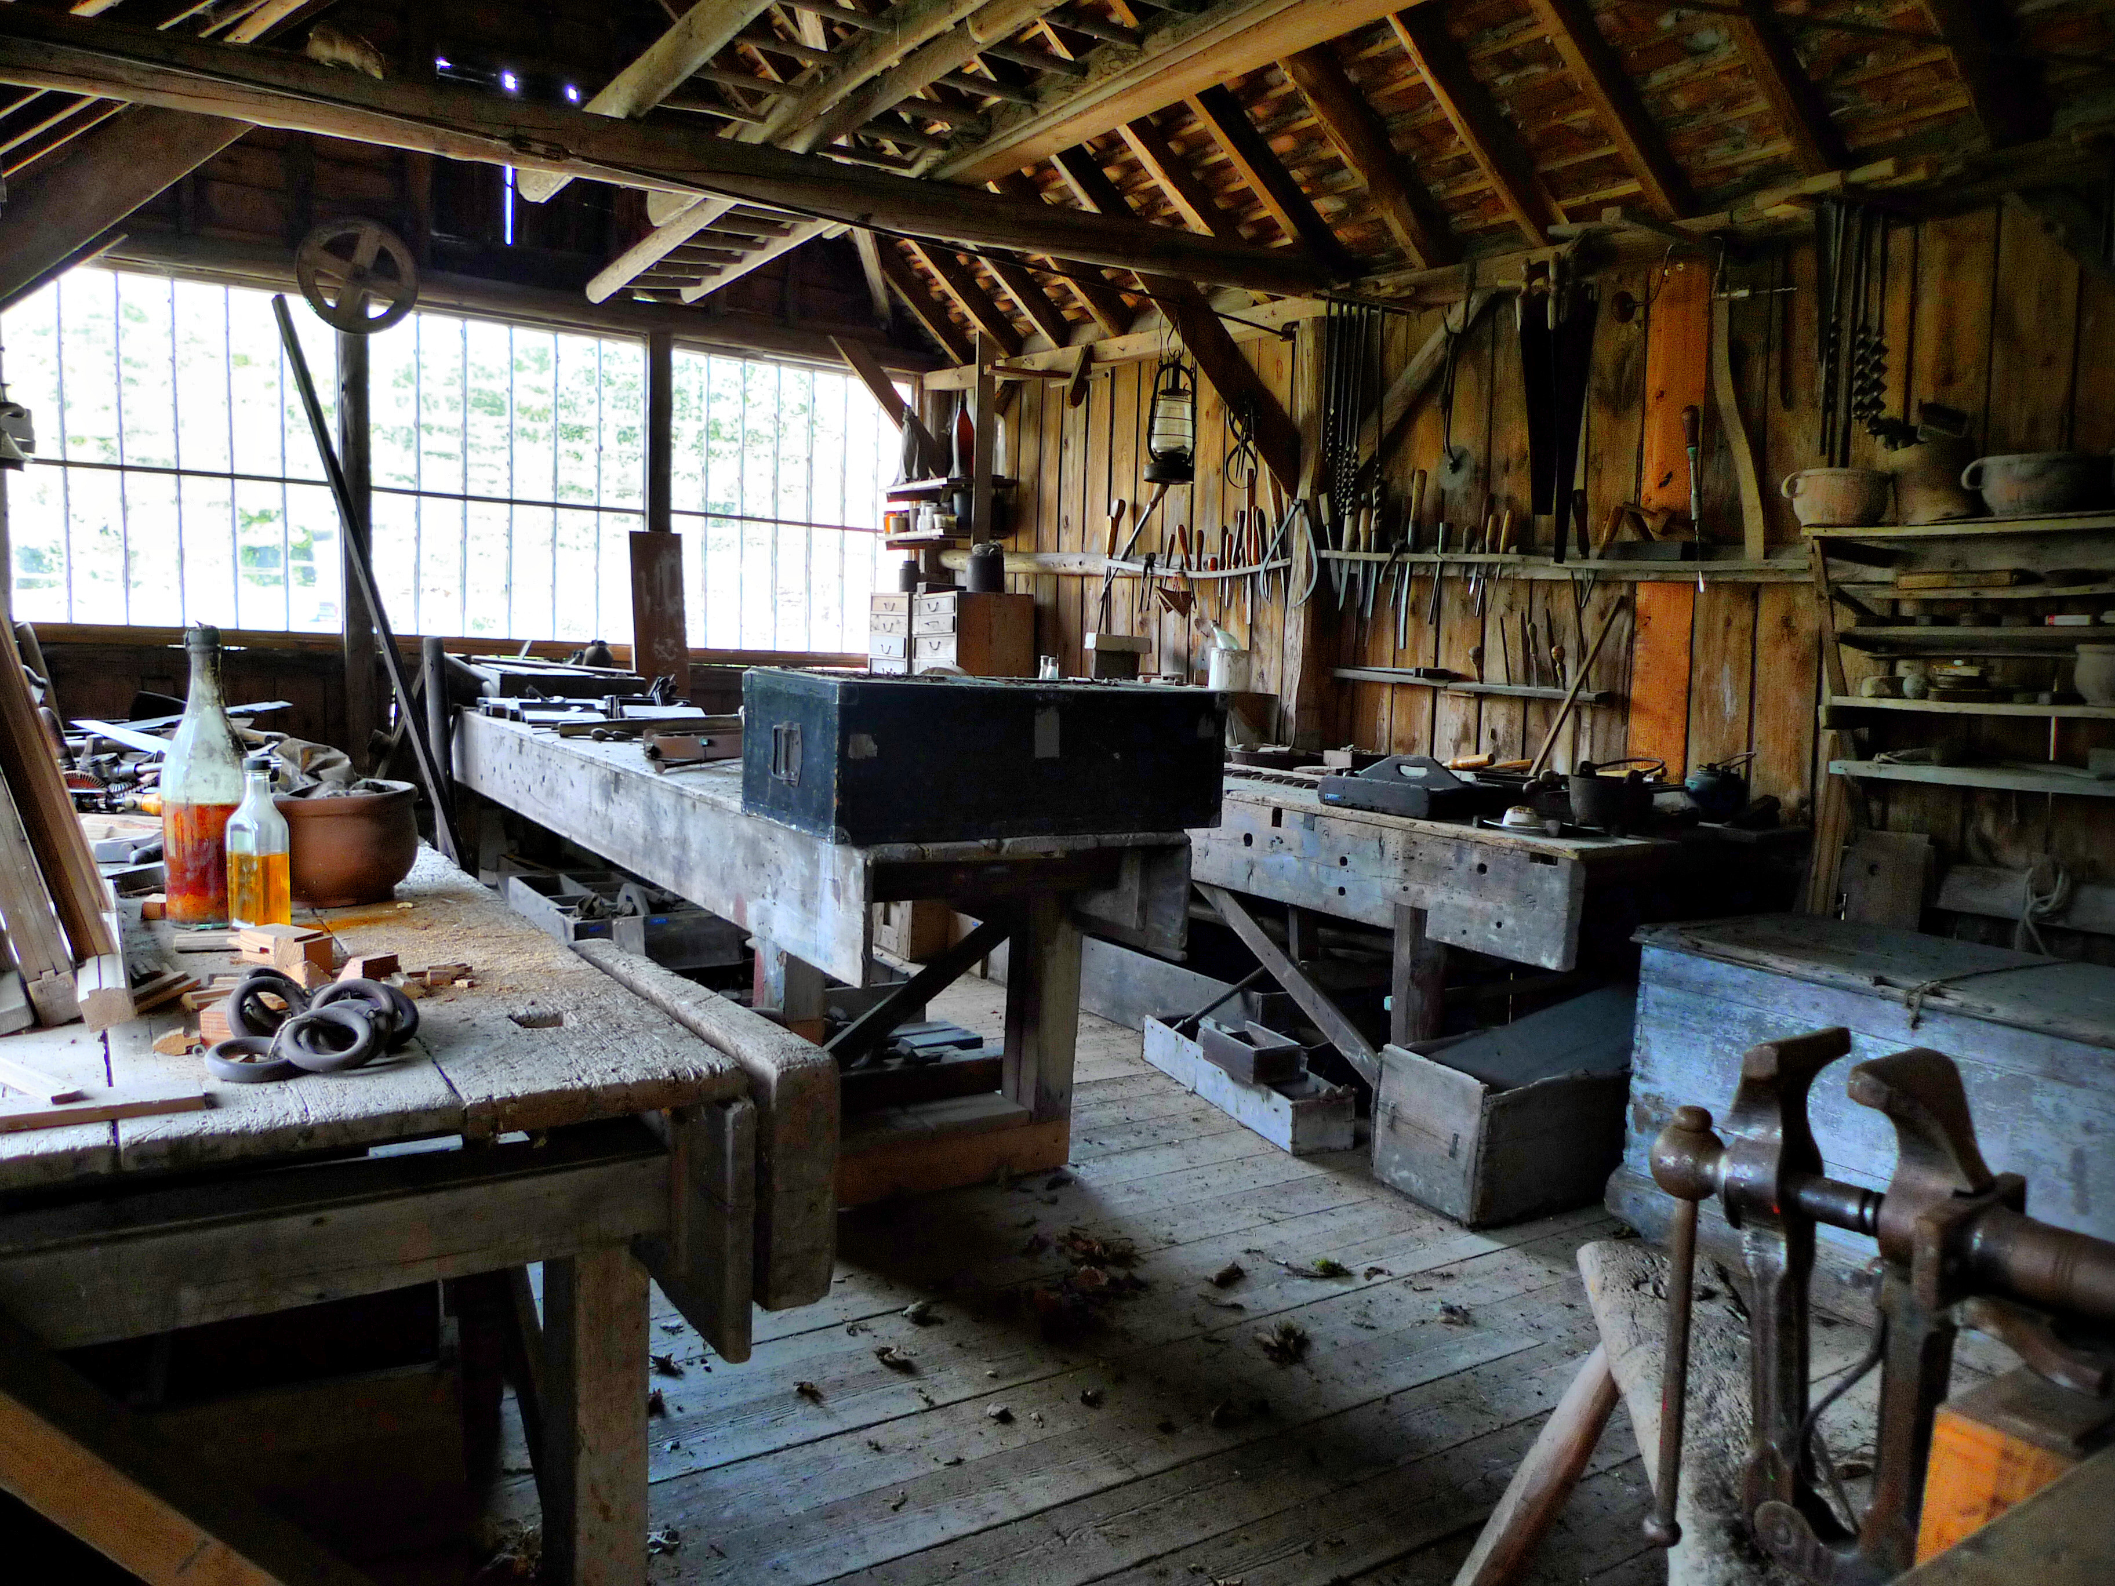
Image by Flickr user dweller88
Notes:
We also do workshops, including some this fall on best practices for your research data,...

Slide 18

Image by US Marine Corps
Notes:
And we are also hosting a Software Carpentry boot camp in January targeted at experimental physics students. Software Carpentry’s goal is to help students become more productive scientists by teaching them basic computing skills like program design, version control, testing, task automation, documentation, and debugging.

Slide 19
amyhodge@stanford.edu
Notes:
CEE newsletter by University Archivist at http://purl.stanford.edu/nr598fg8460

